Slide 1
LMRFC Reference Slide For Crest Tables
LMRFC Forecasts Issued Morning of March 21, 2022
Lower Mississippi
RIVER FORECAST CENTER
Talking Points
The lower Mississippi River is cresting from Baton Rouge, LA to New Orleans, LA.
Minor flooding will continue on the lower Mississippi River at Natchez, MS downstream to Baton Rouge, LA. By this weekend, minor flooding should end at Baton Rouge, LA. Minor flooding will continue for another week or two at Natchez, MS and Red River Landing, LA.
The lower Ohio River and lower Mississippi River above Vicksburg, MS are falling and all locations are below flood stage.
Over the next couple of days, two to six inches of rainfall is forecast for parts of Louisiana and Mississippi extending north into the lower Ohio Valley. This rainfall may cause renewed minor to isolated moderate flooding over smaller tributaries in Arkansas, Louisiana, Mississippi, and west Tennessee.
The 16 day future rainfall guidance continues to show recessions on the lower Ohio River through this week and then renewed rises for early April. The lower Ohio River could return to minor flooding for the first week of April. The rises would prolong flooding at Red River Landing, LA and extend elevated levels on the lower Mississippi River through late April.

Slide 2
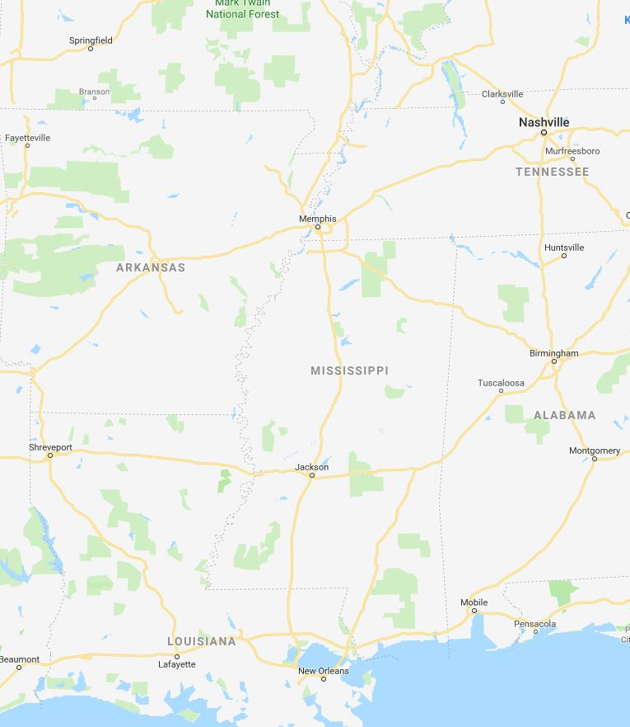
Ohio/Mississippi River Crest Watch
Created March 21 2022 @ 11:00 am CDT
Lower Mississippi River Forecast Center weather.gov/lmrfc
NWSLMRFC
@NWSLMRFC
MS River at Caruthersville
OH River at Paducah
Current: 28.4’
2 Days
Current: 33.1’ ACTION
Forecast:
Continue to fall over the
next 5 days
Forecast:
Falling below ACTION Tomorrow
MS River at Memphis
2 Days
0.5 Day
OH River at Cairo
Current: 25.6’
Current: 38.2’
Continue to fall over the
next 5 days
ACTION
Forecast:
Forecast:
Falling and remaining above ACTION over the next 5 days
MS River at Ark City
5 Days
MS River at Greenville
Current: 33.0’
Current: 44.5’
Continue to fall over the next 5 days
ACTION
Forecast:
Forecast:
Falling and remaining above ACTION over the next 5 days
2 Days
1 Day
MS River at Natchez
MS River at Vicksburg
Current: 49.7’
MINOR
ACTION
Current: 42.0’
Forecast:
Crested and remaining above
MINOR over the next 5 days
Forecast:
Crested and remaining above ACTION over the next 5 days
2 Days
MS River at Baton Rouge
2 Days
MS River at New Orleans
Current: 13.0’
Current: 35.2’
Cresting and remaining steady over the next 5 days
MINOR
Forecast:
Forecast:
Cresting and remaining above MINOR over the next 5 days
Bonnet Carré Location
Crest Location

